Slide 1
Intelligent Query Processing
Gail Shaw

Slide 2
The problems
Incorrect row estimations
cause bad performance
Multi-statement table functions and table variables cause bad performance
Inadequate memory estimations
cause bad performance
Scalar functions cause bad performance

Slide 3
Because
Optimise -> Execute is a linear process
Recompiles only happen if the plan is deemed invalid
Stats changes
Schema changes
Even then, recompiles are before execution starts

Slide 4
Because
Optimise
Execute
Estimate Rows
Request Memory
Choose Joins
Execute Plan
Estimate memory

Slide 5
Four solutions for four problems
Intelligent Query Processing
Adaptive joins
Interleaved execution
Memory grant feedback
Inline Scalar Functions

Slide 6
Adaptive Joins

Slide 7
Adaptive joins
Decision about join type deferred until 1st input has been read
Below a threshold, loop join is used
Above, hash join is used

Slide 8
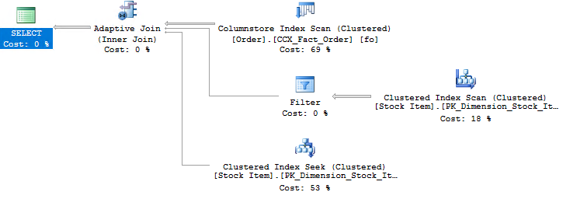
Adaptive joins

Slide 9
Requirements and limitations
Batch mode
Query can be executed with indexed nested loop & hash join
Query plan shape for loop & hash joins must be otherwise identical

Slide 10
Interleaved Execution and Deferred Compilation

Slide 11
Interleaved execution
Multi-statement table-valued function in query
Function is optimised and executed
Then, the outer query is optimised and executed
No more 1 row/100 row table variable row estimates
Notes:
Select, not mod
1-time constants

Slide 12
Deferred Compilation
If a query references a table variable, compilation is deferred until that query has to execute
At that point the rows in the table variable are known
No more 1 row/100 row table variable row estimates
Notes:
Select, not mod
1-time constants

Slide 13
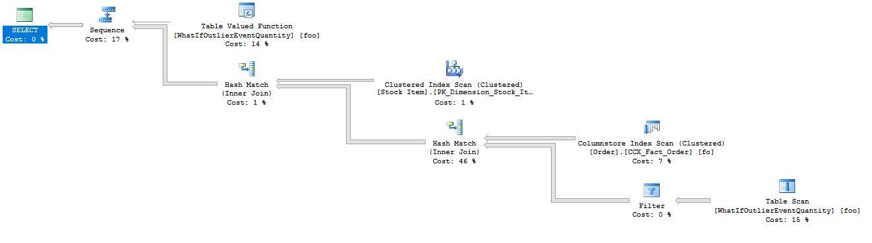
Interleaved execution

Slide 14
Requirements and limitations
Read-only statements (SELECT)
Not used on the inside of a CROSS APPLY

Slide 15
Requirements and limitations
Read-only statements (SELECT)
Not used on the inside of a CROSS APPLY
Number of executions must be determinable at optimization time and deterministic

Slide 16
Memory Grant Feedback

Slide 17
Memory grant feedback
Queries requesting too much memory hog resources
Queries requesting too little memory spill to TempDB
Both are bad

Slide 18
Memory grant feedback
Record if requested memory was too high or too low
Adjust memory request on next execution
Saved with query plan in cache

Slide 19
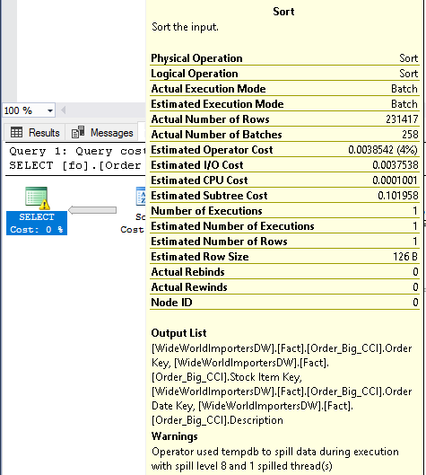
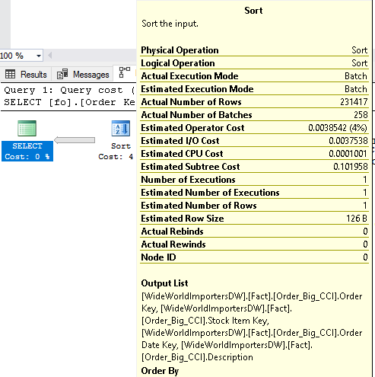
Memory Grant Feedback

Slide 20
Requirements and limitations
Batch-mode or SQL Server 2019
Over- or Under-allocate by 50%

Slide 21
Inline scalar functions

Slide 22
Scalar functions
Scalar functions are not inline in earlier versions
The function is executed once for each row of the query

Slide 23
Requirements and limitations
Looooooong list of requirements (see documentation)
Does not make the function as fast as if it was written as an inline expression

Slide 24
Extended Events
adaptive_join_skipped – not very useful
interleaved_exec_disabled_reason
memory_grant_updated_by_feedback
spilling_report_to_memory_grant_feedback

